Slide 1
Predicting mortgage borrower complaint counts
Author: Christopher Leisner
Date: August 2, 2017

Slide 2
Introduction
Due to the power of social media, consumer complaints about a business potentially have a greater negative impact on the business than ever before
Therefore, it is imperative for businesses to take all reasonable steps to reduce customer complaints
We can use business-related data to predict counts of complaints that the business will receive
We will then introduce some factors that drive counts of complaints by bank mortgage borrowers
These factors and the rules for predicting complaint counts from the factors comprise a predictive model, or just model.

Slide 3
Outline of study
Introduction of data sources for complaint study
Description of modeling data
Definition of variables used to predict complaint counts
Discussion of how predictor variables affect complaint counts
Recommendations for action and further study

Slide 4
Data sources
The data for this study is in two parts:
Bank complaint data
Bank rankings by financial data
The complaint data contains fields such as Complaint ID, Complaint Date, Bank Name, and Product Name
The bank ranking data contains field such as equity capital, amounts past due, nonaccrual loan amounts, etc.

Slide 5
Description of modeling data
The modeling data consists of quarterly complaint counts for 75 banks over a period of 5 years
Complaint counts are adjusted for the size of the bank as measured by the bank’s equity capital
This adjustment is to “level the playing field” for the banks:
It is unfair to compare raw complaint counts for a large bank to the raw complaint counts for a small bank
This is because the large bank will receive more complaints simply because it does more business

Slide 6
Description of modeling data, cont’d
For the same reason, we have adjusted many other quantities in our data by equity capital, including
Amounts past due
Amounts of restructured loans
Amounts of credit card loans

Slide 7
Description of model
Our final model uses the following variables to predict quarterly complaint counts:
Quarterly amount past due 30 – 89 days
Quarterly restructured loan amounts 90+ days past due
Quarterly percentage of loans charged off
Quarterly nonaccrual restructured loans
Quarterly credit card loans

Slide 8
Description of model
We next illustrate how the predictor variables impact predicted complaint count
Each of the following graphs shows the impact of one predictor variable upon an initial complaint count of 100.
In the graphs, the value of the predictor appears on the horizontal axis, while the value of the predicted complaint count appears on the vertical axis
In each graph, we allow the one predictor to vary from its 1st to 4th quartile, while other predictors are held fixed

Slide 9
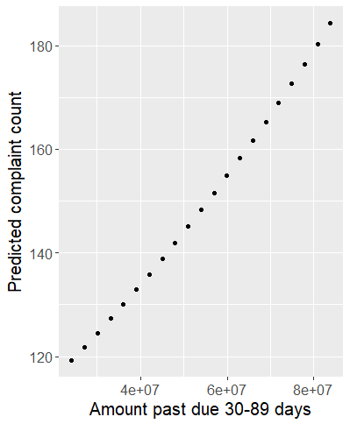
Description of model
Amount past due 30 – 89 days has a high impact on predicted claim counts

Slide 10
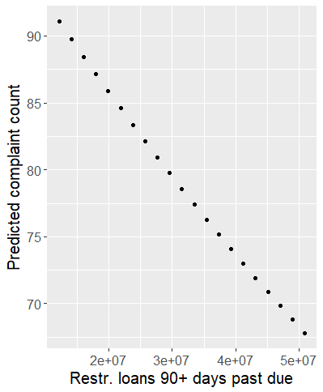
Description of model
Restructured loans 90+ days past due has a high impact on predicted claim counts

Slide 11
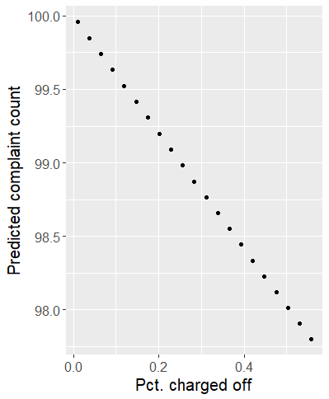
Description of model
Percent of loans charged off has a low impact on predicted claim counts

Slide 12
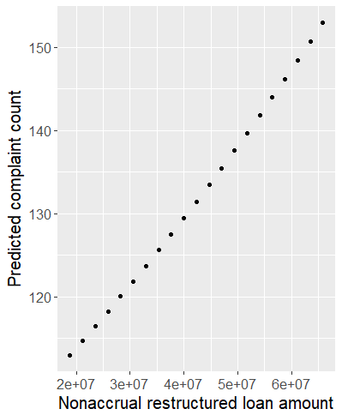
Description of model
Nonaccrual restructured loan amount has a high impact on predicted claim counts

Slide 13
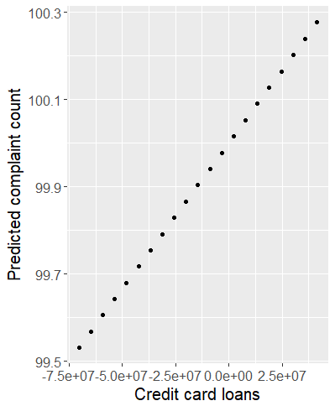
Description of model
Credit card loans have a low impact on predicted claim counts

Slide 14
Evaluation of the model
Call the predicted complaint counts from the model “scores”
Then each bank receives a score for each quarter
We want to see how well the scores correspond to propensity to receive mortgage complaints
To do this, we will partition the bank/quarter combinations into four groups, determined by the quartile of their scores
Then, we will add up the adjusted complaint counts within each group
If the model is accurate, bank/quarters in the first group will receive the fewest complaints, while the bank/quarters in the fourth group will receive the most complaints
On the next slide is a bar chart of the complaint counts per group (which is called a lift chart)

Slide 15
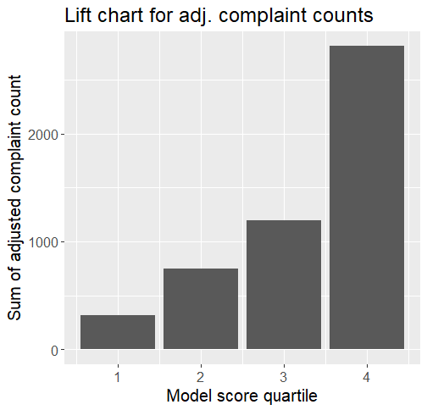
Evaluation of the model
According to the lift chart, the model is quite accurate

Slide 16
Conclusions/recommendations
Banks should only concern themselves with the high-impact predictors in the model
Banks with high complaint counts should modify their loan structuring algorithms to reduce amount past due 30-89 days, and test the effect upon complaint counts
Banks with high complaint counts should experiment with restructuring more severely delinquent loans in ways that are agreeable to borrowers, and test the effect of this upon complaint counts
Repeat this study with a larger number of banks, because the data set in this study was rather small due to difficulties in obtaining data
Repeat this study for other bank products, such as credit cards, car loans, etc.
Drill down into the customer comments in the complaints data to obtain specific reasons for complaints
Attempt a similar study using complaint data from social media, such as Yelp

Slide 17
Thank you

